Slide 1

Project on Web Scrapping & Data Analysis Using Python
Presented By
R JAYAKRISHNAN
Guided By
ROSHANI TALMALE
Department of Computer Science & Engineering
S. B. JAIN INSTITUTE OF TECHNOLOGY MANAGEMENT AND RESEARCH,NAGPUR
An Autonomous Institute, Affiliated to RTMNU, Nagpur

Slide 2
CONTENTS
What is Web Scrapping ?
Web Scraping Architecture
Converting Unstructured data to Structured data
Web Indexing
Web Scraping Using Python
1.Fetching the data
2.Using BeautifulSoup for parsing
3.Export the data
Uses of Web Scraping Services
Data Analysis Using Python
1.Pandas Overview
2.Series
3.DataFrame

Slide 3
WHAT IS WEB SCRAPING
Web Scraping refers to an application that processes the HTML of a Web page to extract data for manipulation such as converting the Web Page to another format (i.e.HTML to XML)
It is also known as Web Harvesting and Web Data Extraction.

Slide 4
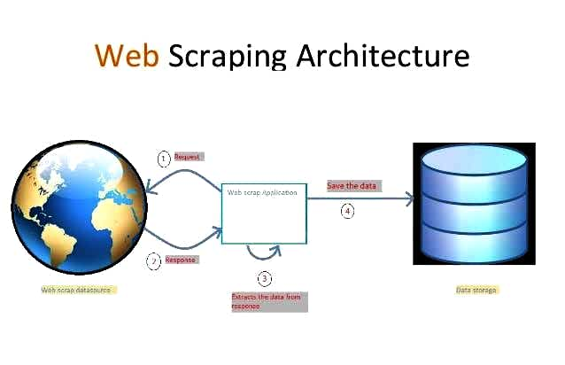

Slide 5
Web Scraping Scripts and applications will simulate a person viewing a Web site with browser. Using these scripts you can connect to a Web Page and request a page, exactly as a browser would do.
The Web server will send back the page which you can then manipulate or extract specific information from.

Slide 6
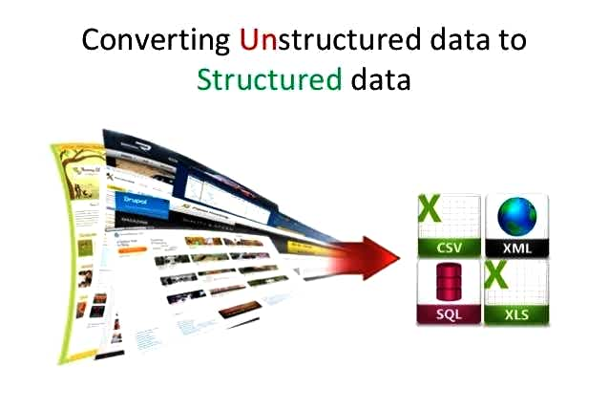

Slide 7
Unstructured content is largely obtained after the scraping process. Structuring the data is the tedious process. But nowadays most of the tools easily does this functionality to segregate the data based on the fields.After the segregation the data is converted into either an API or any other format like
CSV
XML
XLS
JSON

Slide 8
Web Indexing
Web scraping is closely related to web indexing, which indexes information on the web using a hot or web crawler and is a universal technique adopted by most of the search engines.

Slide 9
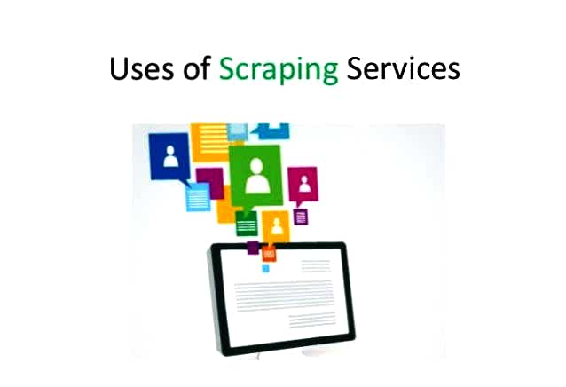

Slide 10
Web Scraping Using Python
Fetching the data
Involves finding the endpoint – URL or URL’s
Sending HTTP requests to the server
Using requests library:
import requests
data = requests.get(‘http://google.com/’)
html = data.content

Slide 11
Web Scraping Using Python
Using BeautifulSoup for parsing
Provides simple methods to-
Searching
Navigate
Select
Deals with broken web-pages really well
Auto-detects encoding

Slide 12
Web Scraping Using Python
Export the data
Database (relational or non relational)
CSV
JSON
File (XML, YAML, etc.)
API

Slide 13
Following are some of the uses of Scraping service:
Online price comparison
Contact scrapping
Weather data Monitoring
Website change detection
To collect data’s for research work
Web mash up
Web data integration
Scraping articles blog and content
Social media crawling
Crawling review data

Slide 14
Data Analysis Using Python
pandas – Purpose and Overview
Python library to provide data analysis features
R
MATLAB
SAS
Built on Numpy , Scipy, and to some extent, Matplotlib
Key Component provided by pandas:
Series
DataFrame

Slide 15
Data Analysis Using Python
pandas Data Structures: Series
One-dimensional array-like object containing data and labels
Lots of ways to build a Series
Country or region
0 | Finland
1 | Denmark
2 | Switzerland
3 | Iceland
4 | Norway

Slide 16
Data Analysis Using Python
pandas Data Structures: DataFrame
Spreadsheet-like data structure containing an ordered collection of columns
Has both a row and column index
Consider as dict of Series (with shared index)
 | Country or region | Score
0 | Finland | 7.809
1 | Denmark | 7.646
2 | Switzerland | 7.560
3 | Iceland | 7.504
4 | Norway | 7.488

Slide 17
Thank You

